Slide 1

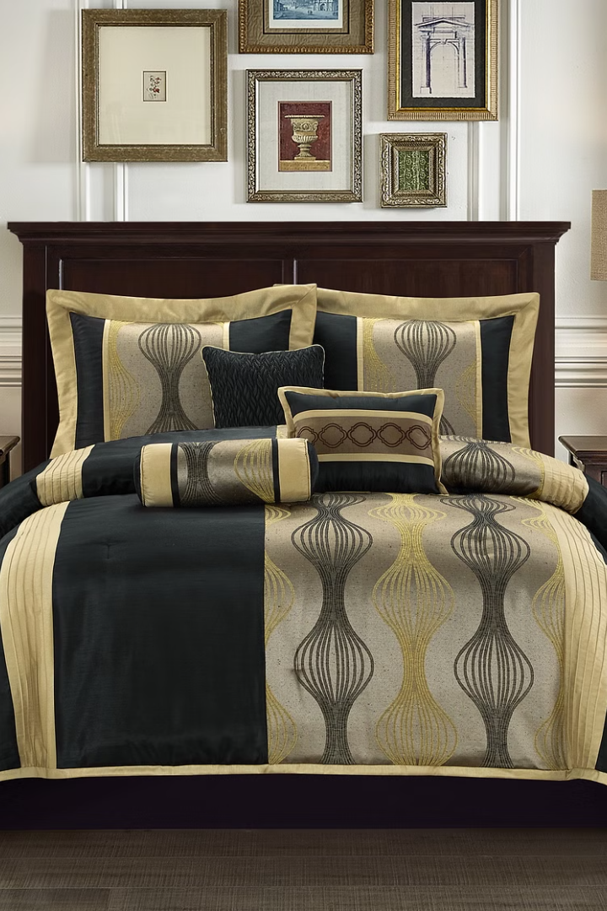
Welcome to Our Bedding Paradise
Explore our high-quality bedding products, including fitted sheets, pillowcases, comforters, pillow shams, and bed skirts. With our search recommendation engine and automated image enhancement, we make your online shopping experience a delight.

Slide 2

ABSTRACT
The Online E-commerce System, conceived to replace manual operations with a computerized infrastructure, seeks to streamline processes and ensure efficient data management.
By integrating user-friendly computer software and readily available hardware, the system aims to provide a comprehensive solution that facilitates error-free, secure, and rapid management. This system not only stores valuable data for extended periods but
also ensures easy accessibility and manipulation of information.
In the context of our specific website, named "Bedicia," this Online E-commerce System serves as the backbone for automating various operational aspects. Bedicia, designed for the global distribution of bedding essentials, leverages cutting-edge technologies to enhance user experience and optimize resource utilization

Slide 3

PROBLEM STATEMENT
1
No-Hassle Returns
2
User-Friendly Feedback
Efficient return and refund process for your convenience.
Give us feedback through our simple, user-friendly form.

Slide 4
SOLUTION STATEMENT

Slide 5
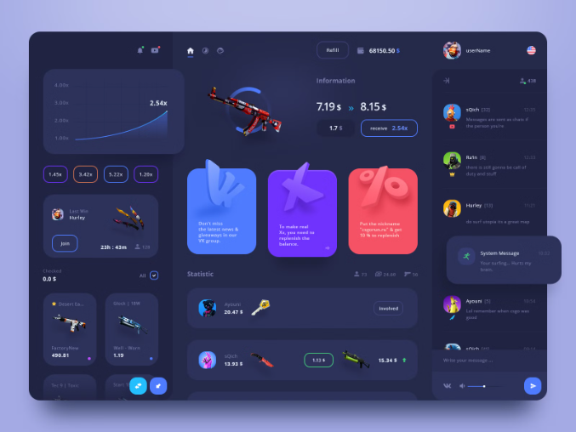
Interactive UI & Customer Support
Interactive UI
24/7 Customer Support
Engage with our highly interactive and user-friendly website interface.
Our dedicated customer support is available round the clock for any assistance you need.

Slide 6
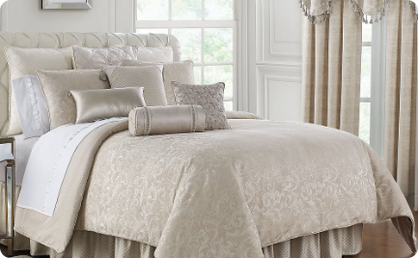


Quality Bedding Collection
Luxurious Comfort
Elegant Designs
Plush & Cozy
Indulge in the softness and comfort of our high-quality bedding collection.
Discover elegant and stylish designs in our pillowcases collection.
Experience the ultimate coziness with our plush comforters.

Slide 7




Guided Shopping Experience
Search with Ease
Our search recommendation engine guides you towards perfect choices.
View Enhanced Images
Explore our enhanced images for a realistic preview of your bedding.
Easy Checkout Process
Smooth and efficient checkout process for a hassle-free shopping experience.

Slide 8
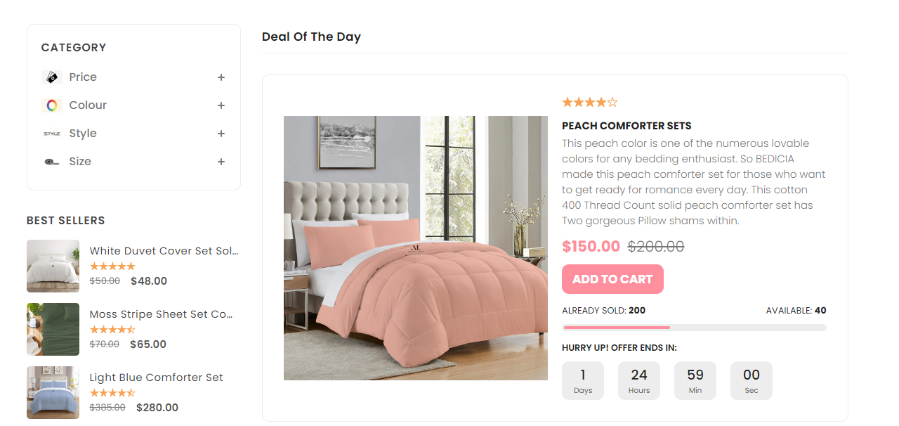
SEARCH-QUERY PAGE

Slide 9
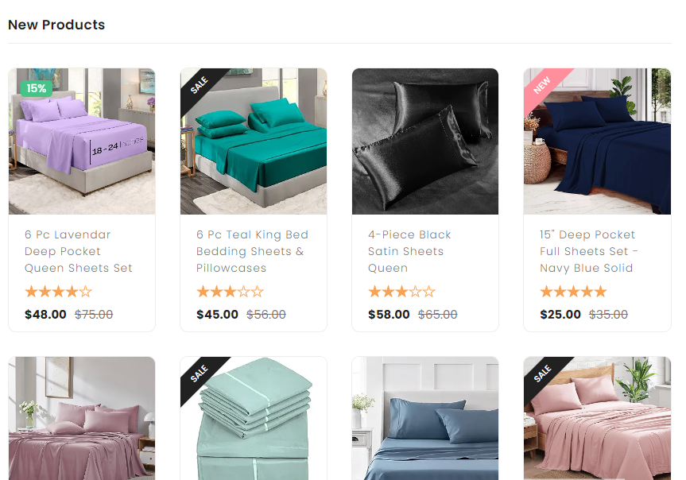
PRODUCT PAGE

Slide 10

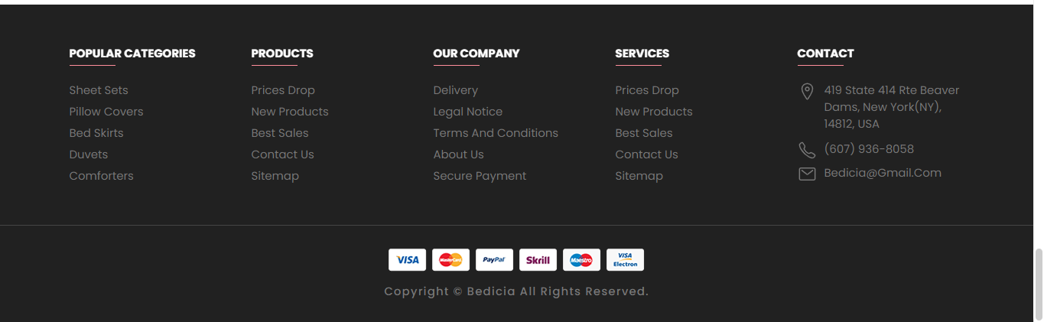
TESTIMONIAL & FOOTER

Slide 11

LANDING PAGE

Slide 12

SIGN UP PAGE

Slide 13


Data Flow Diagrams (DFDs):

Slide 14
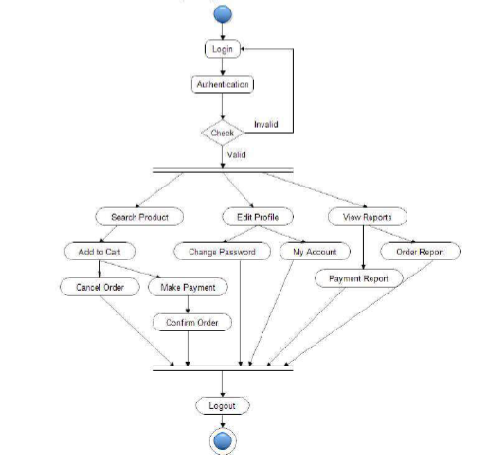
ACTIVITY DIAGRAM

Slide 15
FLOW CHART

Slide 16
CLASS DIAGRAM

Slide 17
ER DIAGRAM

Slide 18
LOGICAL
DATABASE
DESIGN
ER DIAGRAM

Slide 19
CONCLUSION
The development of "Bedicia" underscores the pivotal role of user-centric design in e-commerce. Through personalized preferences and interactive UI elements, the platform aims to elevate the shopping experience, fostering enduring customer loyalty. Emphasizing quality bedding collections,
Bedicia recognizes the importance of meeting customer needs and preferences to stand out in a
competitive market. By prioritizing user satisfaction and engagement, Bedicia transcends transactional interactions, aiming to create immersive shopping journeys.
This approach not only fosters immediate gratification but also cultivates long-term customer loyalty, essential for sustained success in e-commerce. Bedicia's dedication to curating high-value bedding collections demonstrates a profound understanding of its audience's discerning tastes. This commitment to quality products tailored to exceed customer expectations positions Bedicia as more than just an e-commerce platform but a trusted partner in comfort and style pursuits.

Slide 20
FUTURE SCOPE
Advanced Personalization
Augmented Reality Integration
Voice Commerce
Social Commerce
Sustainability Initiatives
Global Expansion
Data Analytics and Insights

Slide 21
REFRENCES
1. Frontend Frameworks and Libraries:
• React.js: Official documentation available at https://reactjs.org/docs/gettingstarted.
html
• Bootstrap: Documentation and examples at
https://getbootstrap.com/docs/5.1/getting-started/introduction/
2.Images:
• freepik.com
3. Machine Learning and Recommendations:
• TensorFlow.js: TensorFlow.js documentation can be found at
https://www.tensorflow.org/js/guide
• Scikit-learn (for machine learning algorithms): Documentation at https://scikitlearn.
org/stable/documentation.html

